Slide 1


PYTORCH
CAPSTONE
PROJECT
Weather Image Classification

Slide 2

CONTENT
Introduction
Dataset
Data Preprocessing
Model Architecture
Training Strategy
Model Evaluation
Summary

Slide 3

INTRODUCTION
The objective of this project is to build an image classification model to identify different weather conditions using a deep learning approach with ResNet18. This project aims to leverage the power of convolutional neural networks to accurately classify images into various weather categories.

Slide 4

DATASET
The dataset used for this project is the Weather Image Recognition from Kaggle, which contains images of 11 different weather conditions. The dataset is well-organized into training and testing folders, with a substantial number of images for each weather category.
The classes are dew, fog, frost, glaze, hail, lightning, rain, rainbow, rime, sandstorm and snow.
The link for the dataset is mentioned here:

Slide 5

DATA PREPROSSING
The dataset was loaded from Google Drive.
The images were resized to 224x224 pixels to match the input size required for ResNet18. Normalization was performed using the standard mean and standard deviation values.
To enhance the training dataset, data augmentation techniques such as random horizontal flip, rotation, color jitter, and random resized crop were applied.
The dataset was splatted 70% into training, 15% into validation and another 15% into test set.

Slide 6
MODEL ARCHITECTURE
The ResNet18 architecture was chosen for this classification task. ResNet18 is a powerful convolutional neural network with 18 layers, known for its effectiveness in image classification tasks.
The architecture includes multiple convolutional layers, batch normalization, ReLU activation functions, and max-pooling layers.
For this project, the final layer was modified by tuning the weights to adapt them to the specific weather dataset.

Slide 7
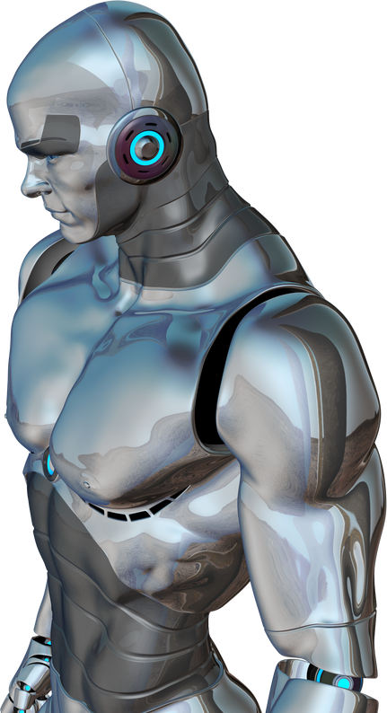
TRAINING STRATEGY
DATA SPLITTING
The dataset was split into training, validation, and test sets, with a ratio of 70%, 15%, and 15%, respectively.
DATA AUGMENTATION
Applied various data augmentation techniques such as random horizontal flip, random rotation, color jitter, and random resized crop to increase the diversity of the training data and prevent overfitting.

Slide 8
TRAINING STRATEGY
TRANSFER LEARNING
Utilized a pre-trained resnet18 model and fine-tuned it on the weather dataset. This approach leverages the learned features from the dataset, providing a strong starting point for training.
TRAINING PARAMETERS
The model was initialized to train for 10 epochs calculating the validation loss and accuracy.

Slide 9
TRAINING STRATEGY
EARLY STOPPING
Implemented an early stopping criterion to monitor the validation loss. Training was stopped preventing overfitting and saving computational resources.
HYPERPARAMETER TUNING
Conducted hyperparameter tuning to identify the optimal values for learning rate, momentum, and batch size. This involved experimenting with different combinations and selecting the ones that resulted in the best validation performance.

Slide 10
TRAINING STRATEGY
HYPERPARAMETER TUNING
The combinations include learning rates of 0.001 and 0.0001 and batch sizes of 16, 32, 64.
Learning Rate: 0.001, Batch Size: 16, Validation Accuracy: 73.05% Learning Rate: 0.001, Batch Size: 32, Validation Accuracy: 82.14% Learning Rate: 0.001, Batch Size: 64, Validation Accuracy: 78.57% Learning Rate: 0.0001, Batch Size: 16, Validation Accuracy: 88.96% Learning Rate: 0.0001, Batch Size: 32, Validation Accuracy: 91.88% Learning Rate: 0.0001, Batch Size: 64, Validation Accuracy: 92.53%

Slide 11
TRAINING STRATEGY
FINE-TUNING
The final layers were trained on the dataset to adapt the model to the specific task.
Once the final layers were trained, specific layers of the pre-trained model were progressively unfrozen and trained with a smaller learning rate.
This allowed the model to retain the valuable features learned from the dataset while fine-tuning it to better suit the weather classification task.

Slide 12
MODEL EVALUATION
The model's performance was evaluated using several metrics and visualizations :
ACCURACY
The test accuracy achieved by the model was 82.50%, indicating the proportion of correctly classified images out of the total test images.
CONFUSION MATRIX
A confusion matrix was generated to visualize the performance across different weather categories. It provided insights into which classes were often confused by the model, helping to identify specific areas for improvement.

Slide 13
MODEL EVALUATION
CLASSIFICATION REPORT
The classification report included precision, recall, and F1-score for each weather category. These metrics offered a detailed understanding of the model's performance in terms of correctly identifying true positives and minimizing false positives and negatives.
VISUALIZATIONS
Confusion Matrix: Displayed as a heatmap to illustrate the distribution of correct and incorrect predictions across the weather categories.
Sample Predictions: Visualized some of the model's predictions alongside the true labels to qualitatively assess its performance.

Slide 14
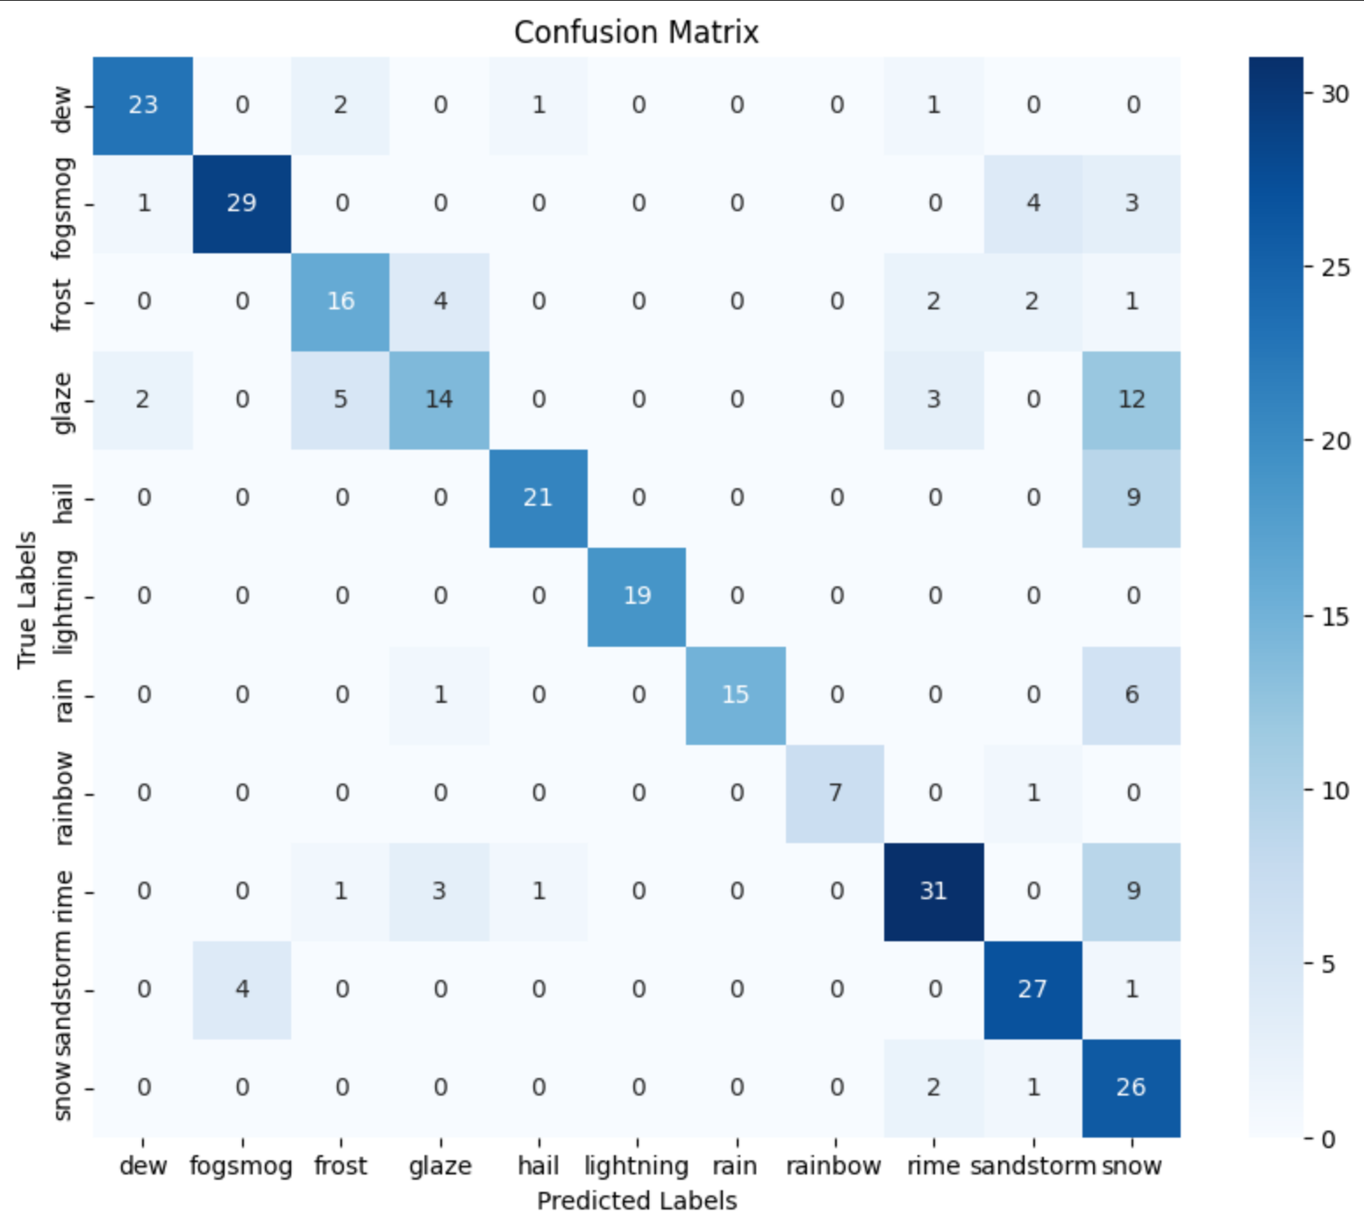
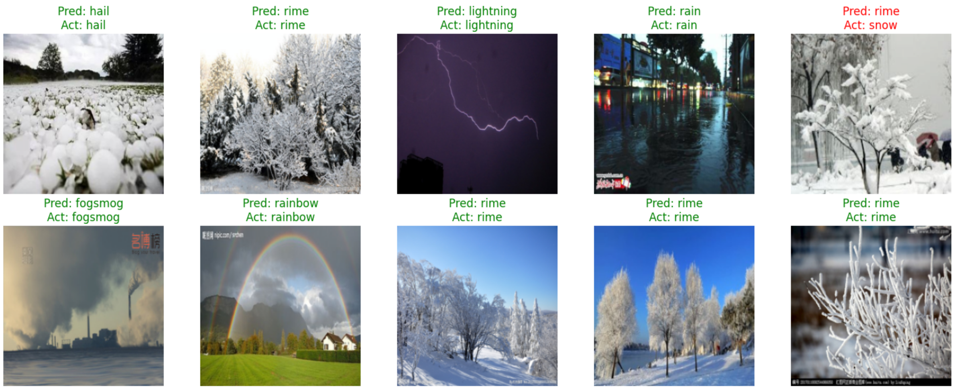
VISUALIZATIONS

Slide 15
SUMMARY
KEY FINDINGS
The model performed well on most weather conditions, with high accuracy in certain categories. The confusion matrix and classification report provided insights into the model's strengths and weaknesses, highlighting areas for improvement.
CHALLENGES FACED
Several challenges were encountered during the project, including handling imbalanced data, dealing with overfitting, and computational limitations. Various strategies, such as data augmentation and regularization techniques, were employed to address these challenges.
LESSONS LEARNED
This project provided valuable insights into the importance of data preprocessing and augmentation. It also demonstrated the effectiveness of transfer learning and fine-tuning pre-trained models. Continuous learning and adapting techniques based on model performance were crucial for success.

Slide 16

REFERENCES
https://keras.io/api/callbacks/early_stopping/
https://www.kaggle.com/datasets/jehanbhathena/weather-dataset
https://www.geeksforgeeks.org/accelerate-your-pytorch-training-a-guide-to-optimization-techniques/
https://www.comet.com/site/blog/image-augmentation-for-computer-vision-tasks-using-pytorch/

Slide 17
THANK YOU!
FOR YOUR ATTENTION
Karan Panchal
1226051
k_panchal225673@fanshaweonline.ca
GitHub

